Slide 1
Phonics to Fluency
Wednesday 8th July 2020
Notes:
Introdcutions

Slide 2
Aims
To understand what is fluency and its importance
To understand the research that has influenced the Phonics to Fluency approach
To understand how the Phonics to Fluency approach is used
To be able to implement this in your own setting
Handbook

Slide 3


What is Phonics to Fluency?

Slide 4
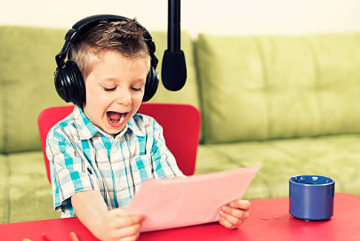
What is fluency?
“Reading fluency refers to efficient, effective word-recognition skills that permit a reader to construct meaning of text. Fluency is manifested in accurate, rapid, expressive oral reading and is applied during, and makes possible, silent reading comprehension.”
Harris & Hodges (1995)

Slide 5
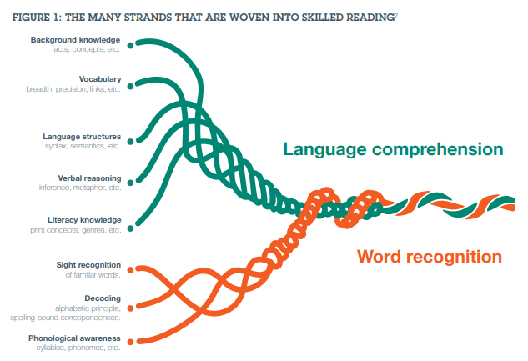
The importance of fluency:
Scarborough’s Reading Rope 2001

Slide 6

Stages of Reading Development
Ehri 1995
See also Frith 1985
Pre-Alphabetic – STOP!
Partial Alphabetic – ‘get, go, give
Full alphabetic
Consolidated alphabetic - night, right, light
bright
(also known as the orthographic stage)

Slide 7

Orthographic Representations
“The visual appearance of words, not just the sound they signify, does matter”
Daniel Willingham

Slide 8
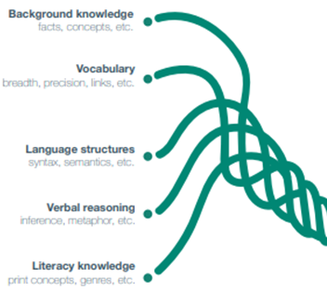

Comprehension
“Teaching reading is not just a matter of teaching reading. The whole curriculum matters, because good readers have broad knowledge in civics, drama, history, geography, science, the visual arts and so on.”
Daniel Willingham

Slide 9

The Basis
Repeated reading
Dahl (1974), Chomsky (1976) and Samuels (1979)
The more frequently you encounter a word, the richer the visual representation. When you become familiar with letter clumps- working memory is reduced.”
Daniel Willingham

Slide 10
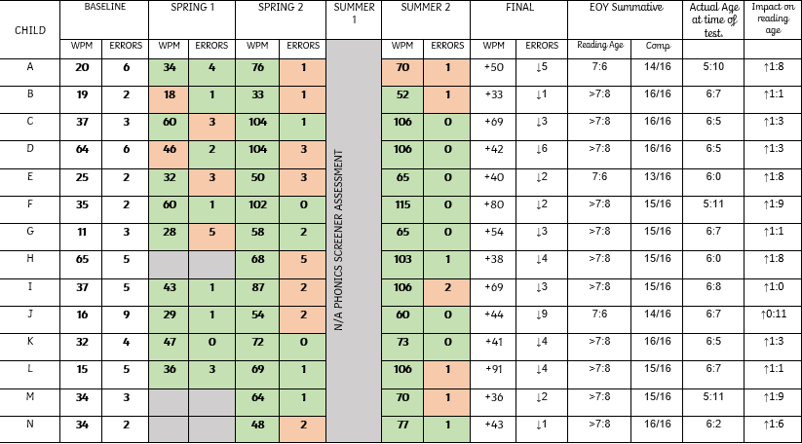
Our Evidence – Year 1 18/19
Average WPM increase: 52 words
Average reduction in errors: 3 words
Standardised Assessment
Average of 1 year 4 months above age

Slide 11

What do I do before?
Identify resources – weekly reading books & assessment texts (x3)
Identify children ready for phonics to fluency
Baseline children using the first assessment text
Timetable – 20 minutes a day

Slide 12
Choosing books - Group
Independent Level | Relatively easy for the student to read (95% word accuracy).
Instructional Level | Challenging but manageable for the reader (90% word accuracy).
Frustration Level | Difficult text for the student to read (less than 90% word accuracy).

Slide 13

Choosing Books- Assessment
Identify the EOY book expectation for your group of children
Select 3 high quality books from this colour band
Label 1,2 and 3
Use on rotation
Intervention - YARC

Slide 14

The Structure
Monday | High quality adult model
Tuesday | Echo reading
Wednesday | Choral reading
Thursday | Partner reading
Friday | Performance

Slide 15

Assessment
Regular
Purposeful
Tracked
Assess:
WPM
Errors
WCPM
Prosody
ORF Hasbrouck & Tindal (2017)

Slide 16

KS2 Intervention
A measurable, evidenced based intervention that can be adapted to different year groups.
Impact of repeated reading on students with learning needs.
Therrin (2004)

Slide 17

2020/21 Research & Support
September – The Science of Reading – how children learn to read
Baseline assessment
November – Prosody & Vocabulary– why is it important? How do we teach it?
Assessment 1
March – Comprehension – what, why and how?
Assessment 2
June – Impact – sharing results
Assessment 3

Slide 18

Thank you
“If our hopes and expectations for our students stretch far- to the highest levels of accomplishment and learning- then our responsibility includes preparing them to read with rigour, independence, precision and insight”
Doug Lemov
j.eccles@pda.lancs.sch.uk

